Slide 1

Advanced UI for Xamarin.Forms
Custom Renderers + Effects
Dhave P. Dayao, Senior Developer @ XAM Consulting

Slide 2
Let Start From The Basics
Xamarin.Forms User Interface

Slide 3
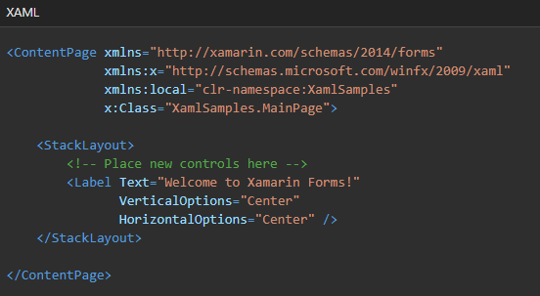
XAML
eXtensible Application Markup Language
XML-based language created by Microsoft
Alternative to programming code for instantiating and initializing objects
And organizing those objects in parent-child hierarchies
XAML is never required in a Xamarin.Forms program
Well suited for MVVM Application Architecture

Slide 4
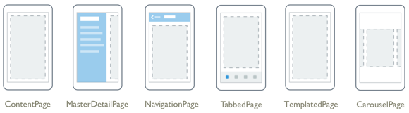
Pages
iOS – ViewController
UWP – Page
Android - Activity

Slide 5
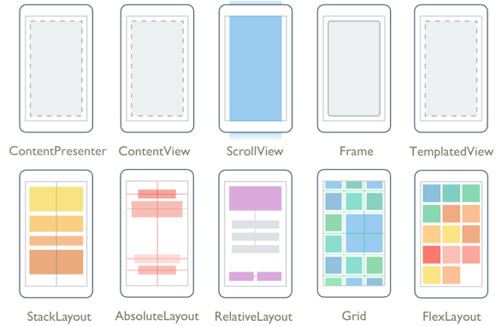
Layouts

Slide 6
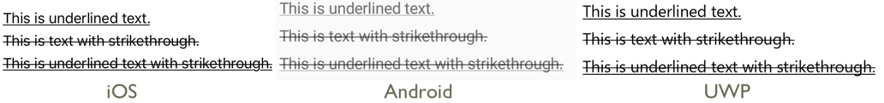
Label

Slide 7
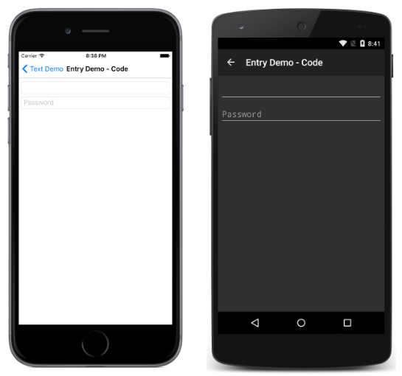


Entry

Slide 8
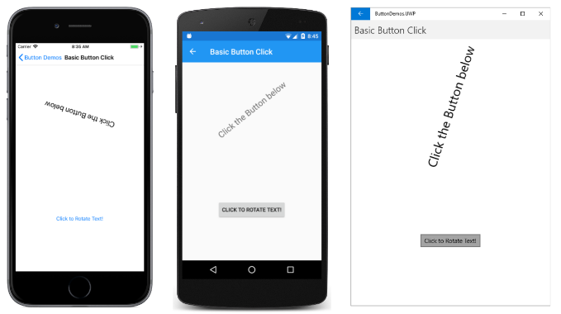
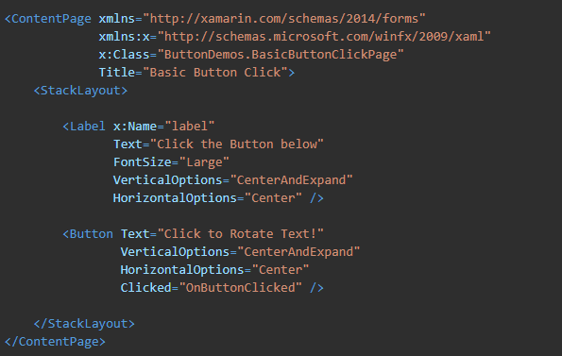
Buttons

Slide 9
Xamarin.Forms UI Capabilities

Slide 10
Question
“
Can I create beautiful UI in Xamarin.Forms?

Slide 11
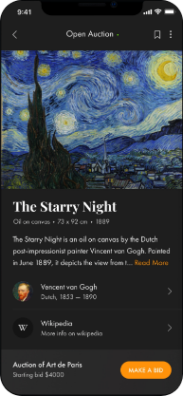
Can I create Beautiful UI in Xamarin.Forms?
The short answer is YES
Source: https://snppts.dev/

Slide 12


Third Party UI Controls
Telerik UI Samples
Other Third Party UI Controls Provider
Syncfusion
DevExpress
Infragistics
ComponentOne
Steema
Grial

Slide 13
How To Customize A Control
Custom Renderers vs. Effects

Slide 14
Custom Renderers
Xamarin.Forms user interfaces are rendered using the native controls of the target platforms
Views | Renderer | iOS | Android | Android (AppCompat) | UWP
ActivityIndicator | ActivityIndicatorRenderer | UIActivityIndicator | ProgressBar |  | ProgressBar
Button | ButtonRenderer | UIButton | Button | AppCompatButton | Button
CarouselView | CarouselViewRenderer | UICollectionView |  | RecyclerView | ListViewBase
CheckBox | CheckBoxRenderer | UIButton |  | AppCompatCheckBox | CheckBox
CollectionView | CollectionViewRenderer | UICollectionView |  | RecyclerView | ListViewBase
DatePicker | DatePickerRenderer | UITextField | EditText |  | DatePicker
Editor | EditorRenderer | UITextView | EditText |  | TextBox
Entry | EntryRenderer | UITextField | EditText |  | TextBox
Image | ImageRenderer | UIImageView | ImageView |  | Image
ImageButton | ImageButtonRenderer | UIButton |  | AppCompatImageButton | Button

Slide 15
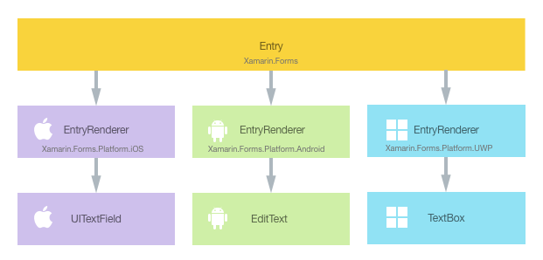
Custom Renderers
Custom Renderers let developers override rendering to customize the appearance and behavior of a control on each platform

Slide 16

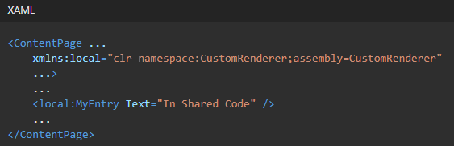
Every Xamarin.Forms control has an accompanying renderer for each platform that creates an instance of a native control. When an Entry control is rendered by a Xamarin.Forms application, in iOS the EntryRenderer class is instantiated, which in turns instantiates a native UITextField control. On the Android platform, the EntryRenderer class instantiates an EditText control. On the Universal Windows Platform (UWP), the EntryRenderer class instantiates a TextBox control. For more information about the renderer and native control classes that Xamarin.Forms controls map to, see Renderer Base Classes and Native Controls.
Custom Renderers
Creating a Custom Entry Control – Have a different Entry background for each platform
Create a new class that will subclass Entry
MyEntry is created in the .NET Standard library project
Consume the Custom control
Can use all Entry Properties
You can also do this on code

Slide 17
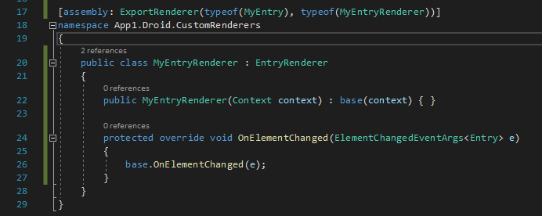
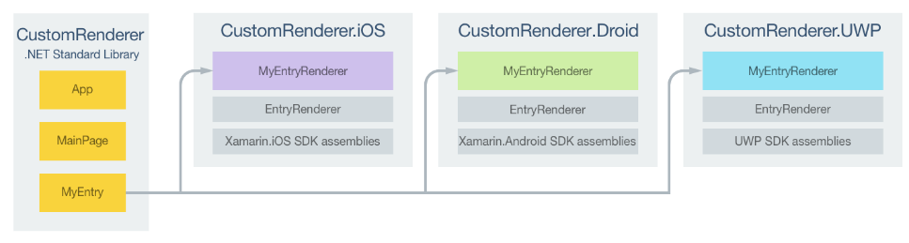
Every Xamarin.Forms control has an accompanying renderer for each platform that creates an instance of a native control. When an Entry control is rendered by a Xamarin.Forms application, in iOS the EntryRenderer class is instantiated, which in turns instantiates a native UITextField control. On the Android platform, the EntryRenderer class instantiates an EditText control. On the Universal Windows Platform (UWP), the EntryRenderer class instantiates a TextBox control. For more information about the renderer and native control classes that Xamarin.Forms controls map to, see Renderer Base Classes and Native Controls.
Custom Renderers
Creating the Custom Renderer on each Platform
Create a subclass of the EntryRenderer class
Override OnElementChanged
Add ExportRenderer attribute to the Renderer class

Slide 18
DEMO
Custom Renderers

Slide 19
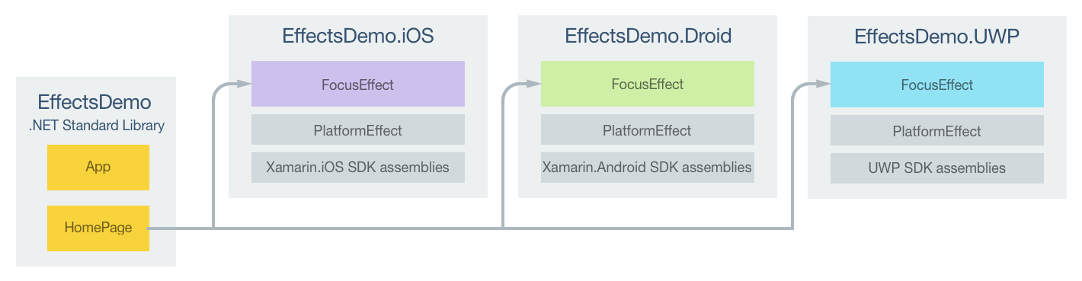
Every Xamarin.Forms control has an accompanying renderer for each platform that creates an instance of a native control. When an Entry control is rendered by a Xamarin.Forms application, in iOS the EntryRenderer class is instantiated, which in turns instantiates a native UITextField control. On the Android platform, the EntryRenderer class instantiates an EditText control. On the Universal Windows Platform (UWP), the EntryRenderer class instantiates a TextBox control. For more information about the renderer and native control classes that Xamarin.Forms controls map to, see Renderer Base Classes and Native Controls.
Effects
Effects allow the native controls on each platform to be customized and are typically used for small styling changes

Slide 20
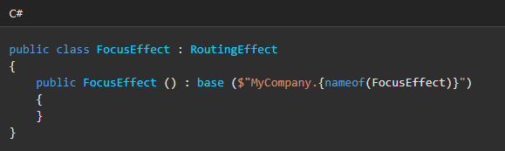
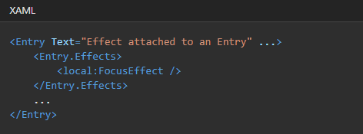
Every Xamarin.Forms control has an accompanying renderer for each platform that creates an instance of a native control. When an Entry control is rendered by a Xamarin.Forms application, in iOS the EntryRenderer class is instantiated, which in turns instantiates a native UITextField control. On the Android platform, the EntryRenderer class instantiates an EditText control. On the Universal Windows Platform (UWP), the EntryRenderer class instantiates a TextBox control. For more information about the renderer and native control classes that Xamarin.Forms controls map to, see Renderer Base Classes and Native Controls.
Effects
Creating an Effect – Change the background color of the Entry control when the control gains focus
Create a subclass of the PlatformEffect class.
FocusEffect is created in the .NET Standard library project
Consume the Effect
You can also do this on code

Slide 21
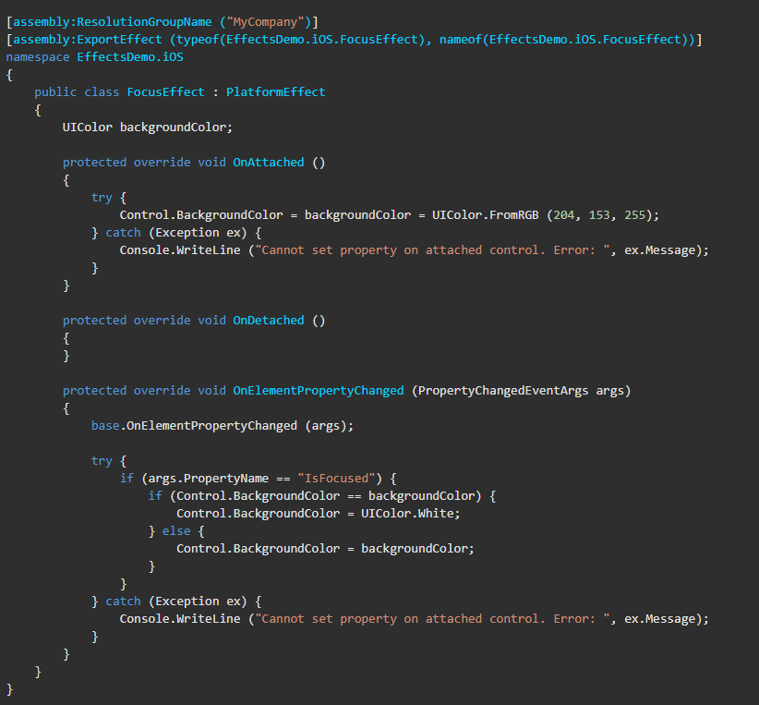
Every Xamarin.Forms control has an accompanying renderer for each platform that creates an instance of a native control. When an Entry control is rendered by a Xamarin.Forms application, in iOS the EntryRenderer class is instantiated, which in turns instantiates a native UITextField control. On the Android platform, the EntryRenderer class instantiates an EditText control. On the Universal Windows Platform (UWP), the EntryRenderer class instantiates a TextBox control. For more information about the renderer and native control classes that Xamarin.Forms controls map to, see Renderer Base Classes and Native Controls.
Effects
Creating the Effect on each Platform
Create a subclass of the PlatformEffect class
Override the OnAttached method
Override the OnDetached method
Add a ResolutionGroupName attribute to the effect class
Add an ExportEffect attribute to the effect class

Slide 22
DEMO
Effects

Slide 23
Question
“
When to use effects and when to use custom renderers?

Slide 24
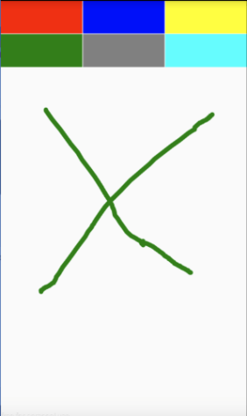
When to use effects and when to use custom renderers?
Use Effects | Use Custom Renderers
When you want a small styling change A good rule could be to use it when you want to modify a property of the native control For example changing the background style of a button, adding an underline to a label, adding a shadow, etc. | When you need to create a new control that doesn’t exist in Xamarin Forms To achieve the control in the image above, Is necessary to use a custom renderer because Xamarin Forms doesn’t have a DrawView, we will have to create our own inhering from View class.

Slide 25
Thank you!
Shoot your Questions!
Dhave P. Dayao, Senior Developer @ XAM Consulting

